Slide 1
Object Oriented
Analysis and Design
ICT2142
Sandaruwani Pathirage
Dept. of ICT
Faculty of Technology
University of Ruhuna

Slide 2
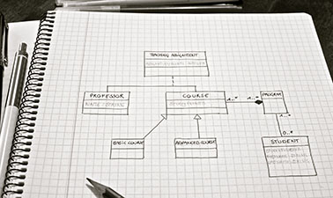
LECTURE 07 :
Class Diagrams

Slide 3
Objectives
After successful completion of this lecture, students should be able to:
  Identify the difference between the domain model vs design model class diagrams.
  Draw class diagrams by analyzing a given scenario.

Slide 4
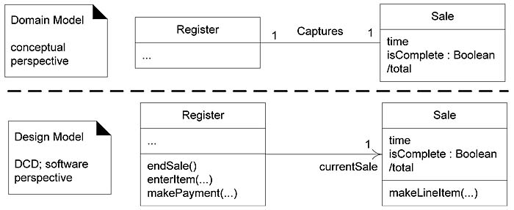
Domain Class Diagram vs Design Class Diagram
A Domain Class Diagram models the concepts in the problem
domain. It usually shows only the class names and relationships and helps define the vocabulary of the problem domain.
A Design Class Diagram models the actual software design.
It includes more detailed information, such as attributes,
operations (methods), visibility, and therefore provides more
detail than a domain class diagram.
Notes:
The transition from analysis to design involves moving from understanding what the system must do (requirements and domain understanding) to determining how the system will do it (implementation details). This transition ensures that business requirements are effectively translated into a structured, implementable software solution.
1. Design Class Diagram (Static View)
Represents the static structure of the system.
It is derived from the Domain Model but includes additional design details such as methods, attributes, and relationships.
Focuses on object-oriented relationships, class hierarchies, and encapsulation.
2. Sequence Diagram (Dynamic View)
Represents the dynamic behavior of the system by modeling interactions between objects over time.
Shows how objects collaborate to achieve a function by specifying message flows.

Slide 5
Design Class Models
Software classes with attributes & operations together
with detailed relationships between the classes.
Design class model extends the domain class model by
refining attributes & relationships, & by refining
operations.

Slide 6
Class Diagrams

Slide 7
Class Diagrams
Provides an overview of a system by illustrating its classes
and the relationships between them.
Also represents the attributes (data) and operations (methods/functions) of each class.
Serves as an effective way to describe the overall structure
and the architecture of system components.
Notes:
It provides a static view of the system, meaning it focuses on how the system is organized rather than how it behaves during execution.

Slide 8
Finding Classes
There are two common approaches for identifying classes in a system:
  Noun–Verb Analysis
  CRC Analysis (Class–Responsibility–Collaboration)

Slide 9
Finding classes using noun/verb analysis
Noun–verb analysis has been used for many years and works well
because it is based on the direct analysis of the language used in the
problem domain.
When a Text Description is Given,
Nouns and noun phrases in the text usually indicate classes or
attributes of classes.
Verbs and verb phrases indicate the responsibilities or operations
(methods) of a class.
Notes:
Example : University Course Registration
Problem Description:
“Students enroll in courses offered by the university.”
Identified nouns:
Student
Course
University
Hidden Class:
Enrollment
Why it is hidden:
The system must track which student registered for which course, semester, grade, etc.
Possible class:
Enrollment
- enrollmentID
- semester
- grade

Slide 10
Finding classes using noun/verb analysis
It is also important to identify “hidden classes”, which are inherent
to the problem domain, but may not be explicitly mentioned in
the description (In University Course Registration system, students enroll in courses offered by the university.”)
Note:
Be careful when interpreting synonyms (different words with the
same meaning) and homonyms (words that have multiple meanings), as they may lead to incorrect identification of classes or operations.
Example: Order
Order (purchase request) – in an e-commerce system.
Order (command/instruction) – in a military or management system.
Notes:
Example : University Course Registration
Problem Description:
“Students enroll in courses offered by the university.”
Identified nouns:
Student
Course
University
Hidden Class:
Enrollment
Why it is hidden:
The system must track which student registered for which course, semester, grade, etc.
Possible class:
Enrollment
- enrollmentID
- semester
- grade

Slide 11
Step 01 – Noun Phrase Identification
The Portfolio Manager shall be able to roll up portfolios on several levels.
A Trader shall be able to place orders on behalf of a portfolio that generate one or more
trades.
A Portfolio Manager shall be able to select a purchase method in conjunction with placing a sell order.
A trade entry shall generate forecasted cash flows associated with the given trade lot.
The system shall match up actual cashflows with forecasted cashflows.
The system shall automatically generate appropriate postings to the General Ledger.
The system shall allow an Assistant Trader to modify trade data and propagate the results accordingly.
Identify the nouns and noun phrases in this example system definition.
Notes:
.

Slide 12
Step 0 – Noun Phrase Identification
The Portfolio Manager shall be able to roll up portfolios on several levels.
A Trader shall be able to place orders, on behalf of a portfolio, that generate one or more trades.
A Portfolio Manager shall be able to select a purchase method in conjunction with placing a sell order.
A trade entry shall generate forecasted cash flows associated with the given trade lot.
The system shall match up actual cashflows with forecasted cashflows.
The system shall automatically generate appropriate postings to the General Ledger. The system shall allow an Assistant Trader to modify trade data and propagate the
results accordingly.
Identify the nouns and noun phrases in this example system definition.

Slide 13
Step 02 – Noun Phrase Consolidation
After identifying nouns and noun phrases,
Make plural terms singular.
Eliminate duplicate terms.
Consolidate synonyms into single term.
Place list in alphabetic order.

Slide 14
Step 02 – Noun Phrase Consolidation
Portfolio Manager | portfolios | levels
Trader | orders | portfolio | trades
Portfolio Manager | purchase method | sell order
trade entry | cash flows | trade lot
system | actual cash flows | forecasted cash flows
system | postings | General Ledger
system | Assistant Trader | trade data | results

Slide 15
Step 02 – Noun Phrase Consolidation
Assistant Trader | Portfolio | System
Cash Flow | Portfolio Manager | Trade
General Ledger | Posting | Trade Data
Level | Purchase Method | Trade Entry
Order | Result | Trade Lot
Sell Order | Trader
After the consolidating noun phrases
Notes:
(Nouns and noun phrases may indicate classes or class attributes. Verbs and verb phrases may indicate responsibilities of classes)

Slide 16
Step 03 – Noun Phrase Analysis
  Now, remove:
  References to the system itself or to its context.
  Nouns which appear out of the scope of the project.
  Nouns which are too vague.
  Nouns which represent actions.
  Actors might be removed from our list of candidate
  classes, and placed instead on the use case
  diagrams.
Notes:
(Nouns and noun phrases may indicate classes or class attributes. Verbs and verb phrases may indicate responsibilities of classes)

Slide 17
Step 03 – Noun Phrase Analysis
Assistant Trader | Portfolio | System
Cash Flow | Portfolio Manager | Trade
General Ledger | Posting | Trade Data
Level | Purchase Method | Trade Entry
Order | Result | Trade Lot
Sell Order | Trader
 | actions
 | actors
 | out of the scope of the project
 | too vague
 | reference to the system itself

Slide 18
Step 04 – Draw Initial Analysis Class Model
Draw an initial analysis class model showing only class names,
generalizations (inheritance), and associations.
Just as noun phrase analysis helps identify candidate classes, verb
phrase analysis helps identify relationships between classes.
The result can be represented as a table showing candidate
associations among the candidate classes.
Example:
Student enrolls in Course
Professor teaches Course

Slide 19
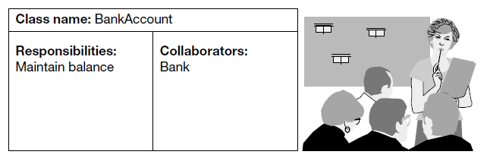
Finding classes using CRC analysis
Stands for class, responsibilities and collaborators
Uses the world’s most powerful analysis tool, the sticky note!
Begin by marking up some sticky notes as shown below.

Slide 20
Finding classes using CRC analysis
A CRC card is divided into three compartments:
  Top compartment: Name of the candidate class
  Left compartment: Responsibilities of the class
  Right compartment: Collaborators of the class
Collaborators are other classes that help a class fulfill its responsibilities.
Thus, the collaborators compartment helps record the relationships between classes.
CRC analysis is a two-phase activity:
  Brainstorming – gather information
  Analysis – examining and refining the information

Slide 21
Class Diagram Notations

Slide 22
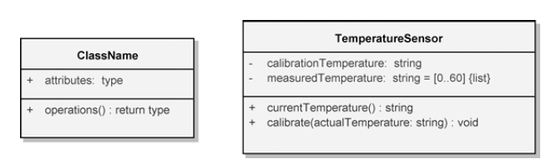
Classes
A class is a description (or blueprint) of a set of objects that
share the same attributes, operations (methods), relationships, and
behavior.
In a UML class diagram, each class is represented by a
rectangle divided into three compartments:
    Class Name
    Attributes
    Operations

Slide 23
Visibility Modifiers in UML Class Diagrams
Visibility modifiers are used to indicate the accessibility of attributes and operations in a class.
Adornment | Visibility Name | Semantics
+ | Public | The attribute or operation is accessible from any other class.
- | Private | The attribute or operation is accessible only within the same class.
# | Protected | The attribute or operation is accessible within the class and its subclasses.
~ | Package (Default) | The attribute or operation is accessible only to classes within the same package.

Slide 24
Example
Student
+ studentID : Integer - password : String # email : String ~ address : String
+ registerCourse() : Void + dropCourse() : Void - calculateGPA() : Float
+ public attribute/operation
- private attribute/operation
# protected attribute/operation
~ package visibility

Slide 25
Class Attributes & Methods
Attributes (fields, instance variables)
visibility name : data_type
Example:
- balance : double
Operations / methods
visibility name (parameters) : return_type
Example:
+ calDistance(p1: double): double

Slide 26
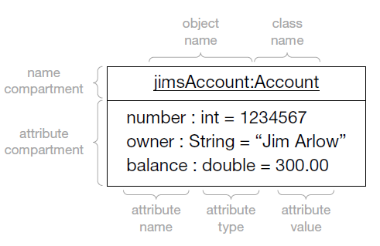
Object
Object : An instance of a class
The top compartment contains the object identifier, which is
always underlined.

Slide 27
Relationships - Association
An association connects two classes and represents a meaningful
relationship between them.
It is indicated by a straight line between the classes.
A class may have an association with itself, which is called a
reflexive association.
Associations may be further decorated with multiplicity to
indicate how many objects participate in the relationship.

Slide 28
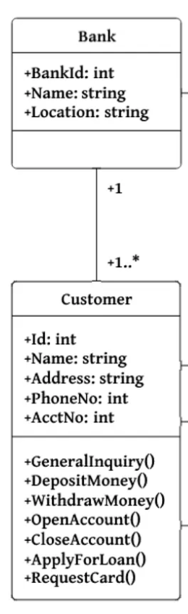
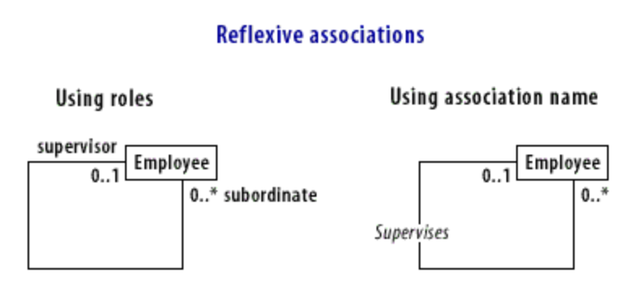
Relationships - Association

Slide 29
Relationships - Directed Association
A simple relationship where one class is linked to another with an explicit
direction.
A specific type of association where one class directly knows about or
uses another class.
Typically, the relationship is one-directional, meaning one class depends
on or references the other.
It is represented by a line with an arrow pointing toward the class being
referenced.
Example: A Car has an Engine
Car Engine
A car knows about its engine, but an engine doesn’t need to know about a specific car.

Slide 30
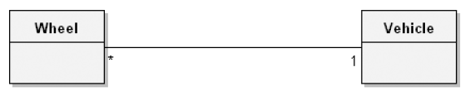
Multiplicity
How many instances of class A can be associated with one
instance of class B.
A single instance of vehicle can be associated with many
wheel instances.
Multiplicity is applied to the target end of an association and denotes the number of links between each instance
of the source class and instances of the target class.

Slide 31
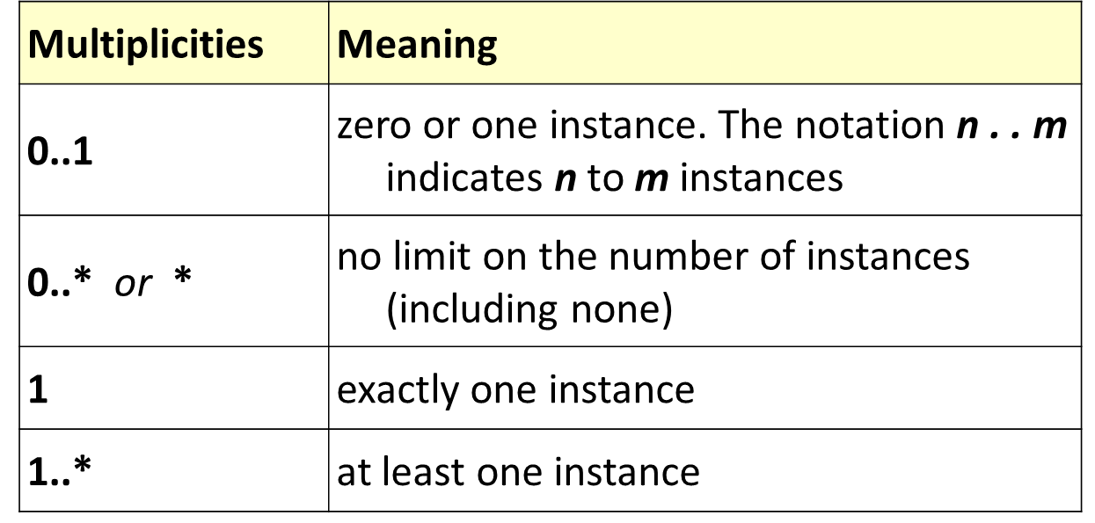
Multiplicity

Slide 32
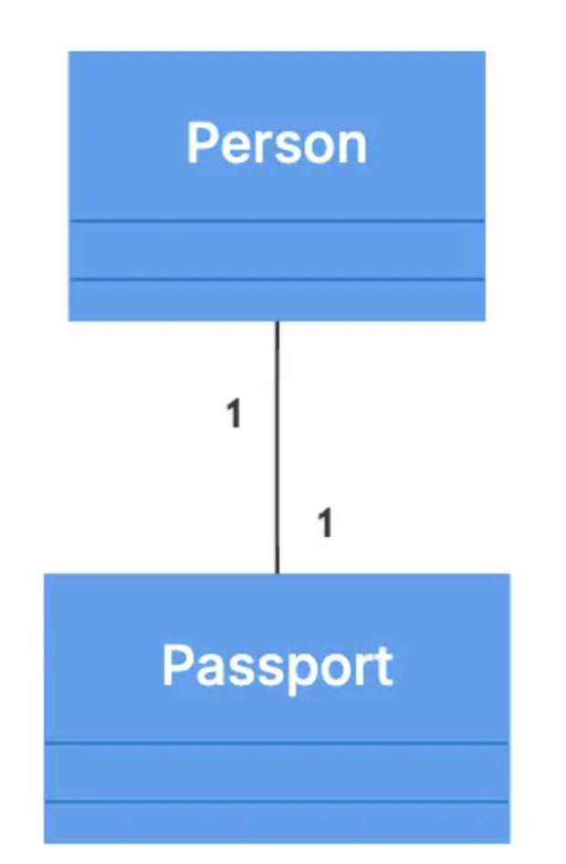
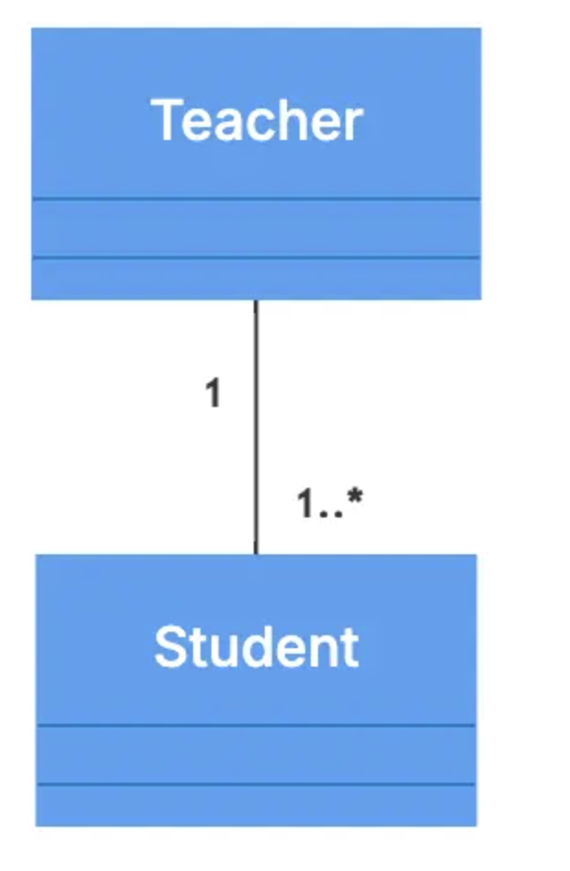
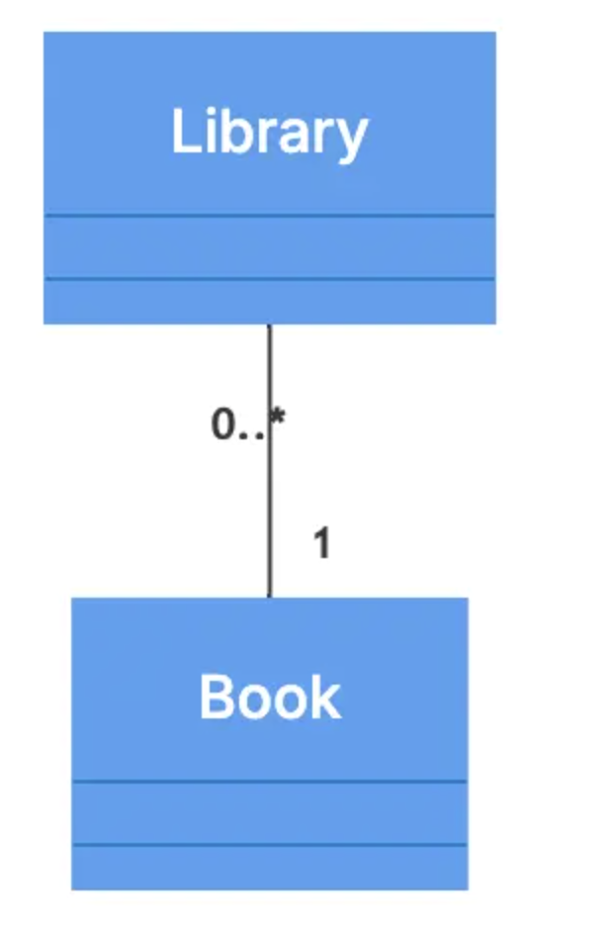
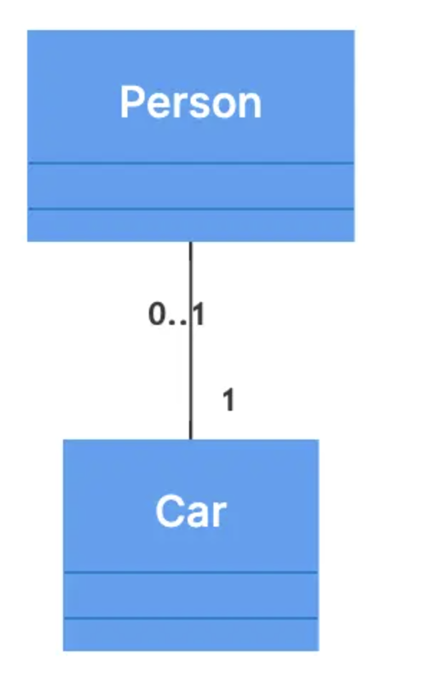
Multiplicities
A teacher can teach multiple students.
Each person has exactly one passport.
A library can have zero or more books.
A person may or may not own a car.

Slide 33
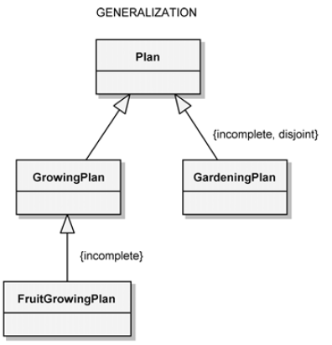
Relationships- Generalization
The generalization icon
denotes a generalization/
specialization relationship
(the “is a” relationship).
Appears as an association with a closed arrowhead.
The arrowhead points to
the superclass, and the
opposite end of the
association designates
the subclass.

Slide 34
Relationships - Dependency
A temporary or weak relationship where one class depends on another but does not own it.
Student
Library Card
- - - - - - - - - >
Client Class
Supplier Class
  A Student depends on a Library Card to access books and other library resources. However, the Library Card does not depend on the Student, it exists independently and can be reassigned to another student if needed.
Notes:
Dashed line

Slide 35
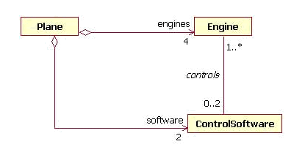
Relationships - Aggregation
  A constrained form of the association relationship “has-a” relationship.
  An association where one class belongs to a collection.
  e.g. Instructor is part of the Faculty
  Indicated by an empty diamond on the side of the
  collection to denote the aggregate (the whole).
Notes:
Hollow diamond

Slide 36
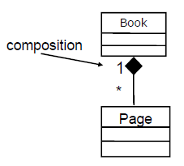
Relationships - Composition
  Strong form of Aggregation.
  Components cannot exist without the aggregate.
  Indicated by a solid diamond on the side of the collection.
  The multiplicity at this end is 1 because the parts are
  defined as having no meaning outside the whole, which
  owns the parts.
  “is entirely made of” relationship

Slide 37
Relationships - Composition
1
1..*
Room
House
The diamond is placed at the whole/owner side (House).
A House is composed of one or more Rooms.
Each Room belongs to exactly one House.
If the House is destroyed, the Rooms also cease to exist.

Slide 38
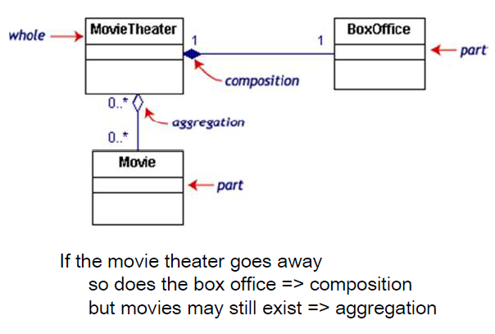
Composition / Aggregation Example
Notes:
A Box Office is a place where tickets for movies, plays, concerts, or other events are sold.

Slide 39
Exercise
Draw a UML Class Diagram representing the following elements from the problem domain of a hockey league. Make sure to label all associations with appropriate multiplicities.
A hockey league is made up of at least four hockey teams. Each hockey team comprises six to twelve players, and one player captains the team. A team has a name and a record. Players have a number and a position. Hockey teams play games against each other. Each game has a score and a location. Teams are sometimes led by a coach. A coach has a level of accreditation and several years of experience and can coach multiple teams. Coaches and players are people, and people have names and addresses.
Assumptions:
  each player only plays on one team
  each captain only captains one team
  each team only plays in one league
Notes:
Notes: captain could alternatively be represented as a second, named association between player and team. Assumptions: each player only plays on one team, each captain only captains one team, each team only plays in one league.
League: An association of sports teams that organizes matches for its members

Slide 40
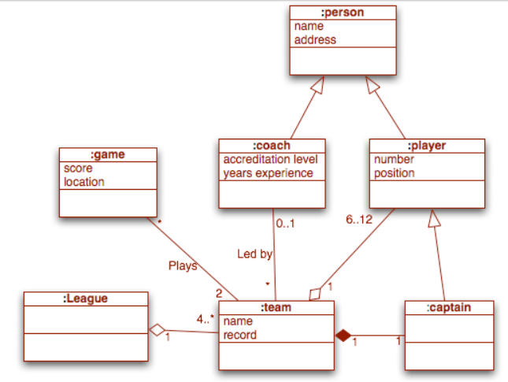
Answer

Slide 41
THANK YOU!

